Slide 1
DFT II - Tirgul 7

Slide 2
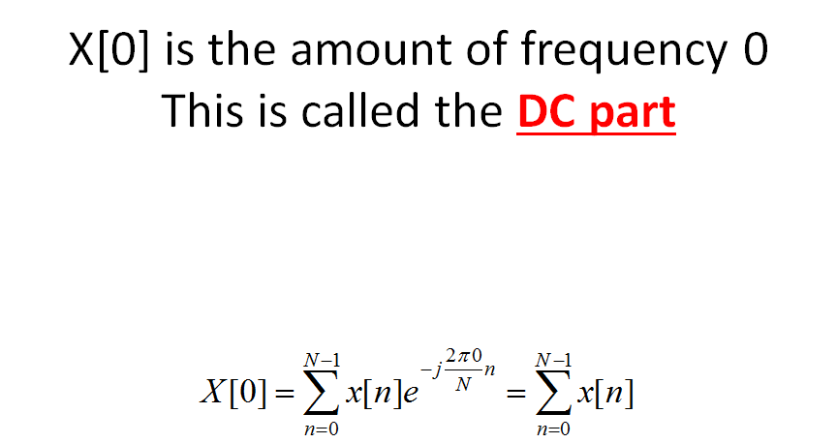
We normalize the DC value by N
(Remember that we normalize all the other values by N/2)

Slide 3
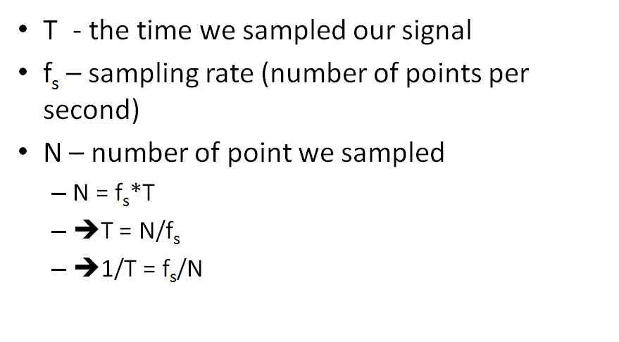
Resolution of DFT

Slide 4
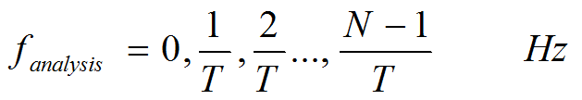
Resolution of DFT
Example
We have a 5 seconds signal, and Fs = 10Hz.
How many points do we have (N)?
What is the resolution of F_analysis?
What is the nyquist frequency (what is the center of the DFT graph)?
T = signal duration
The F_analysis vector serves as the x-axis of the spectrum plot (e.g. we plot the amplitudes of the fft as a function of F_analysis).
F_analysis resolution is equal to 1/T

Slide 5
Resolution of DFT
Solution
We have a 5 seconds signal, and Fs = 10Hz.
How many points do we have (N)? 50 points
What is the resolution of F_analysis? 1/5Hz
What is the nyquist frequency? 5Hz

Slide 6
The phase of the DFT result
For frequency k, X[k] = a+bi
The phase of frequency k is atan(b/a).
It shows the phase of each frequency
relative to cosine

Slide 7
Example #1:
Given:
Fs = 100Hz
T=1Sec
N = ?
t = arange(0,T,1/Fs);
x = 6.*np.cos(2*np.pi*5 *t+ np.pi/4) + 4*np.sin(2*np.pi*3*t);
X = np.fft(x)./(N/2)
X[3Hz] = 0 + 4i
X[5Hz] = 4.2426 + 4.2426i
Phase[5Hz] = atan(4.2426/4.2426) = pi/4

Slide 8
Example #2:
Given:
Fs = 100Hz
T= 3Sec
N = ?
t = arange(0,T,1/Fs);
x = 3*np.sin(2*np.pi*3*t) + 6*np.cos(2*np.pi*5*t + pi/8)
X = np.fft(x)./(N/2)
X[5Hz] = 5.5433 + 2.2961i
X[3Hz] = 0 - 3i
Phase[5Hz] = atan(2.2961/5.5433) = pi/8
Phase[3Hz] = atan(3/0) = -pi/2

Slide 9
•Let x= 5*cos(2*pi*12)+ 2*cos(2*pi*18)
•You sampled 200 points in 0.5 seconds
–What is the frequency resolution?
–What is the Nyquist frequency?
–How will the abs power spectrum will look like?
–How will the angle spectrum will look like?

Slide 10
•Let x= 5*cos(2*pi*12)+ 2*cos(2*pi*18)
•You sampled 200 points in 0.5 seconds
–What is the frequency resolution?
–What is the Nyquist frequency?
–How will the abs power spectrum will look like?
–How will the angle spectrum will look like?

Slide 11
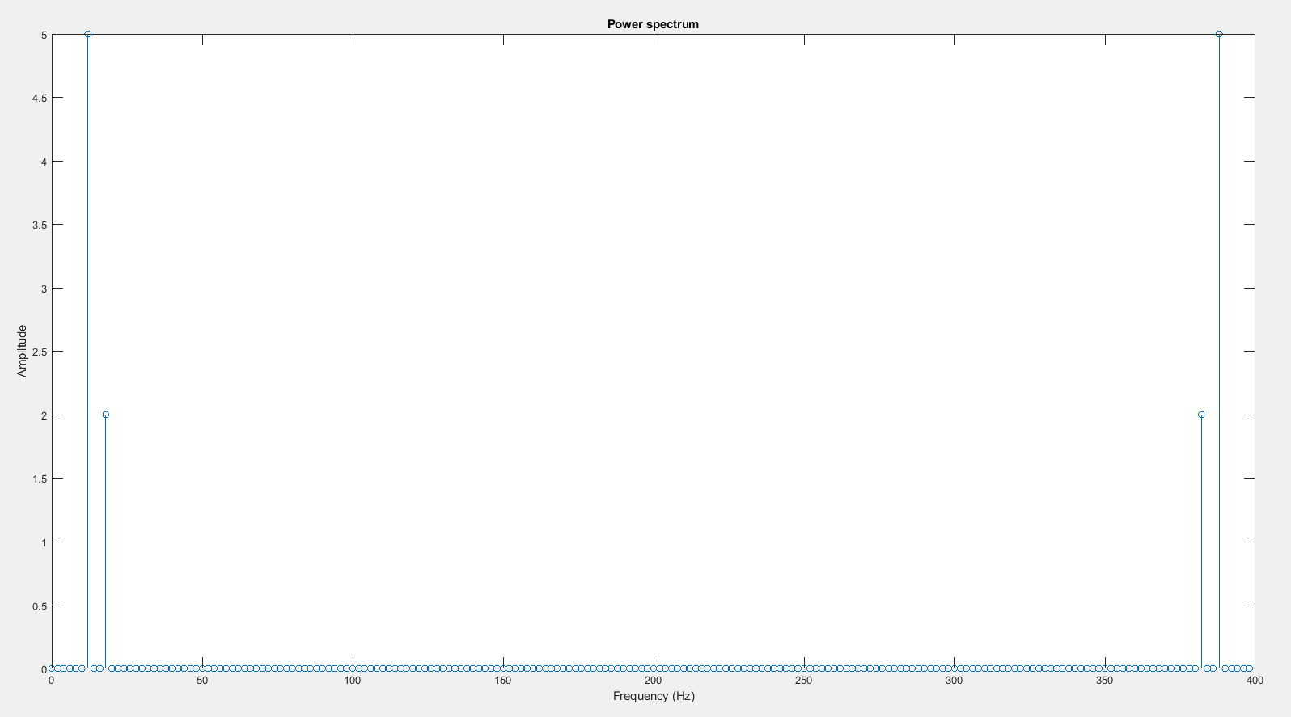
Power spectrum

Slide 12
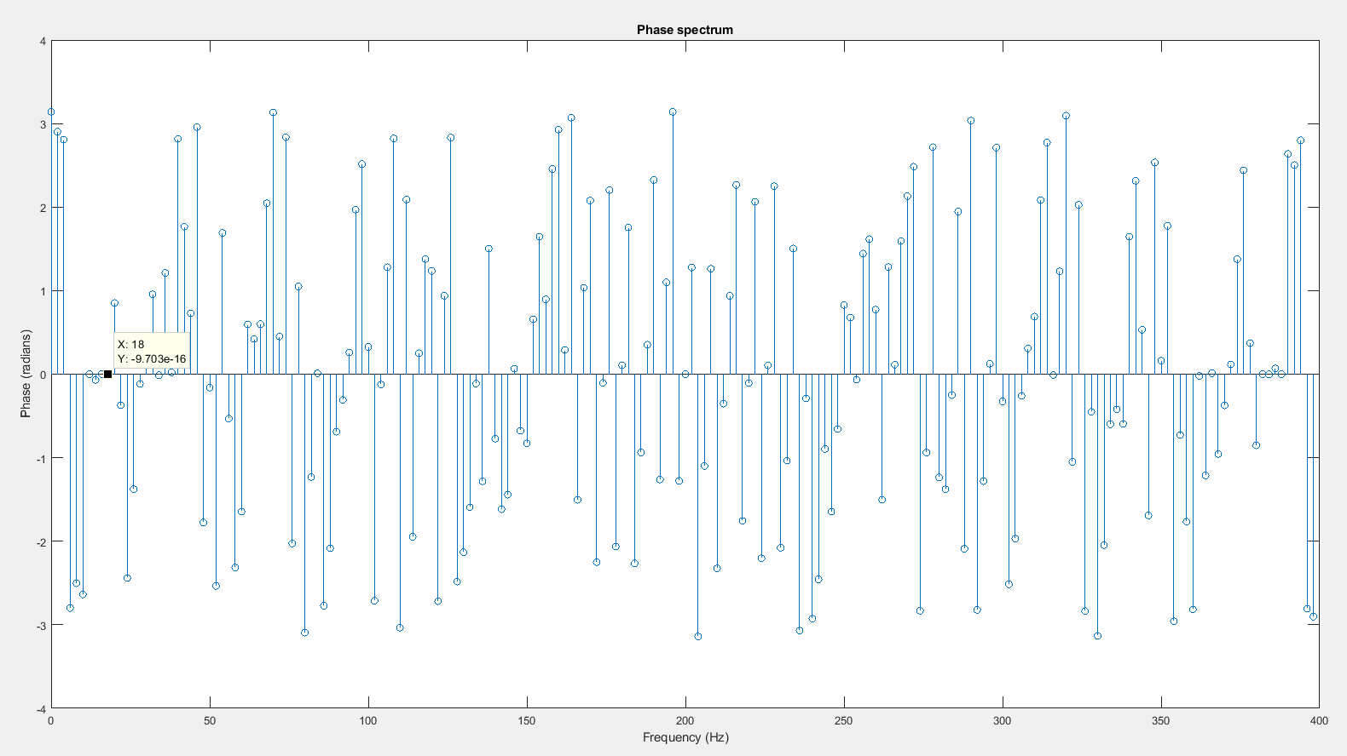
Angle:

Slide 13
Another example
Let x= 2*sin(2*pi*10)+ 5*sin(2*pi*16)
You sampled 50 points in 2 seconds
What is frequency resolution?
How will the power spectrum will look like?
How will the angle spectrum will look like?

Slide 14
Solution
We have alias! Fs of 25Hz is below the Nyquist frequency
(which should be at least 16Hz*2 = 32Hz)
F alias = |16-25| = 9Hz
Resolution:
N=50, T=2, fs = 50/2 = 25 Hz
f_{analysis} = 1/T = 0.5 Hz
Frequency range = 0,0.5,1,….24.5 Hz
Spectral analysis:
The frequencies should be 10 and 9 Hz
Their amplitudes are 2 and 5 respectively
f_{analysis} divides 10 and 9 so we should expect a peak at each of these frequencies and in the symmetric parts

Slide 15
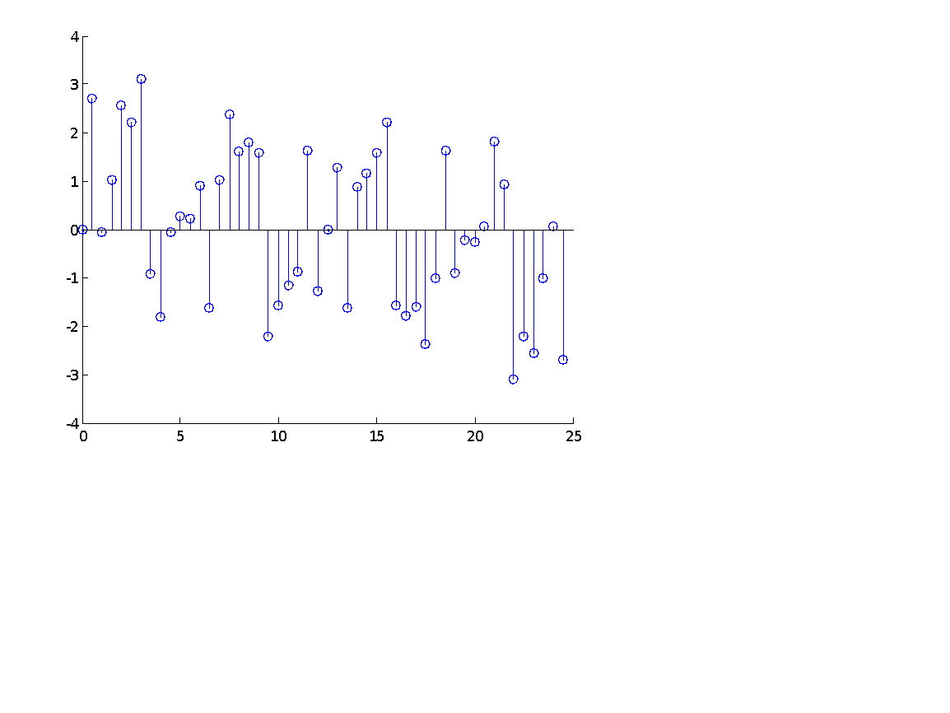
Solution
5
Angle spectrum
We have only sinus so the phase
should be -pi/2 in 9 and 10 Hz
Note that following the alias the -pi/2 phase
Of 9Hz was flipped to pi/2.
4.5
4
3.5
3
Amplitude
2.5
2
1.5
1
0.5
0
0
5
10
15
20
25
Frequency (Hz)
Phase
Frequency (Hz)

Slide 16
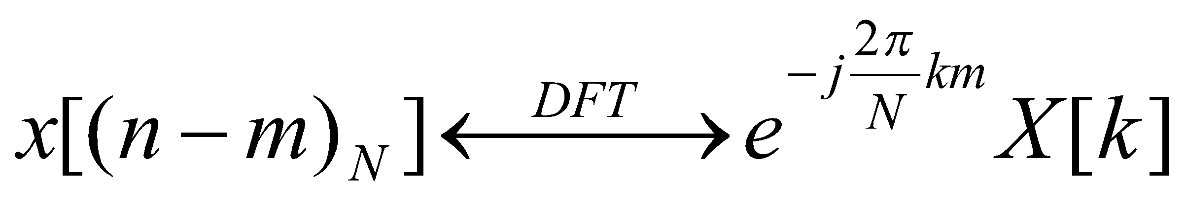

Phase theorem
Shifting the signal in the time domain DOES NOT affect the frequencies in the Frequency domain. It does however, changes the Phase.
circular shift on time domain leads to a phase shift on frequency domain.
for a time shift of m samples, the phase shift at the kth frequency will be

Slide 17
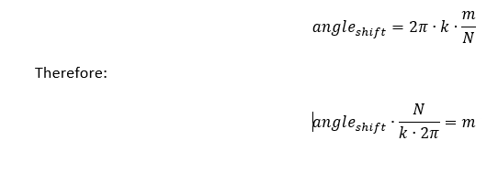
Phase theorem
phase shift on frequency domain → cyclic shift on time domain:

Slide 18
Leakage
Leakage happens when our signal has frequencies that fall between values we can measure using our resolution.
We will see some power in nearby frequencies.

Slide 19
Code example of:
The effect of sampling time on Leakage.
Leakage with aliasing. Leakage correction using zero padding.
Leakage correction using Hanning

